Slide 1
Lecture 4: Floodfill

Slide 2
Floodfill Overview
First assume that there are no walls
Give each cell a distance from the goal. The goal has distance 0.
Repeat until we reach the goal:
Go to the neighboring cell with the smallest distance to the goal
Run the update distances algorithm (see later slide)

Slide 3
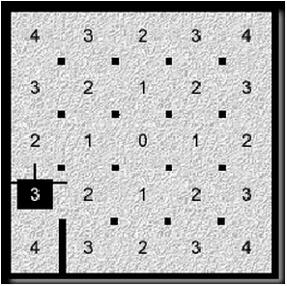
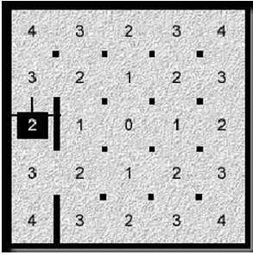
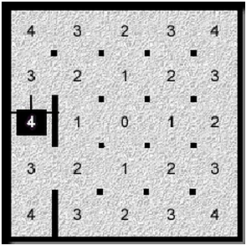
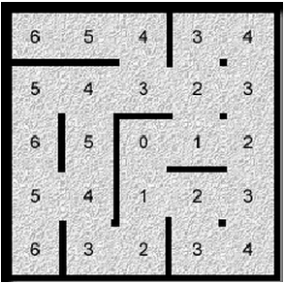
Example

Slide 4
Maze Representation
Each cell has a distance (0-252 for a 16 x 16 maze) and 4 walls (1 bit each). You may also want to have a “visited” bit for speed runs.
When you discover a wall, you need to update it in the current cell, and the neighboring cell.
You can get around this by giving each cell only 2 walls, but you need an extra dummy row/col.
If you use the “visited” bit, then you don’t need to run the floodfill update algorithm on cells that you have already visited, meaning you can go faster on them.

Slide 5
Print maze function
It is essential for debugging to be able to print out your maze
Should look something like this:
+---+---+---+
|*5 *4 V3 |
+---+---+ +
| 0 1 2 |
+---+---+---+
Use ‘+’ for posts. Use “---” for north/south walls. Use ‘|’ (pipe) for east/west walls. Use ‘*’ for visited. Use <, >, ^, V for the direction of the mouse.

Slide 6
Update distances algorithm (no recursion)
Make sure the stack is empty
If there are any new walls discovered:
Push the current cell and the cells adjacent to the new walls onto the stack
While the stack is not empty:
currCell <- pop the top of the stack
The distance of currCell should be the minimum open neighbor distance + 1
If it is not, then set it to that value and push all open neighbors to the stack

Slide 7
Tips
Run your floodfill algorithm as soon as your mouse enters the cell, not when it reaches the center of the cell.
Write a simulator in Visual Studio to test your function.
Also use Green’s maze generation excel sheet to create test mazes.
The stack for the update distances algorithm should be 512. (Note that it is possible to add a cell more than once, therefore 255 may not be enough).
Place your stack outside of any function (make it global).
You might run out of memory if you place large arrays inside of functions.
Global variables go into a different region of memory, where there is more space.
Don’t use recursion.
You usually want to avoid using recursion on embedded systems, since it is slow and wastes more memory than a stack-based method.

